Slide 1
Nebular Hypothesis THeory
Objective: explain how solar systems, like ours, were created.

Slide 2
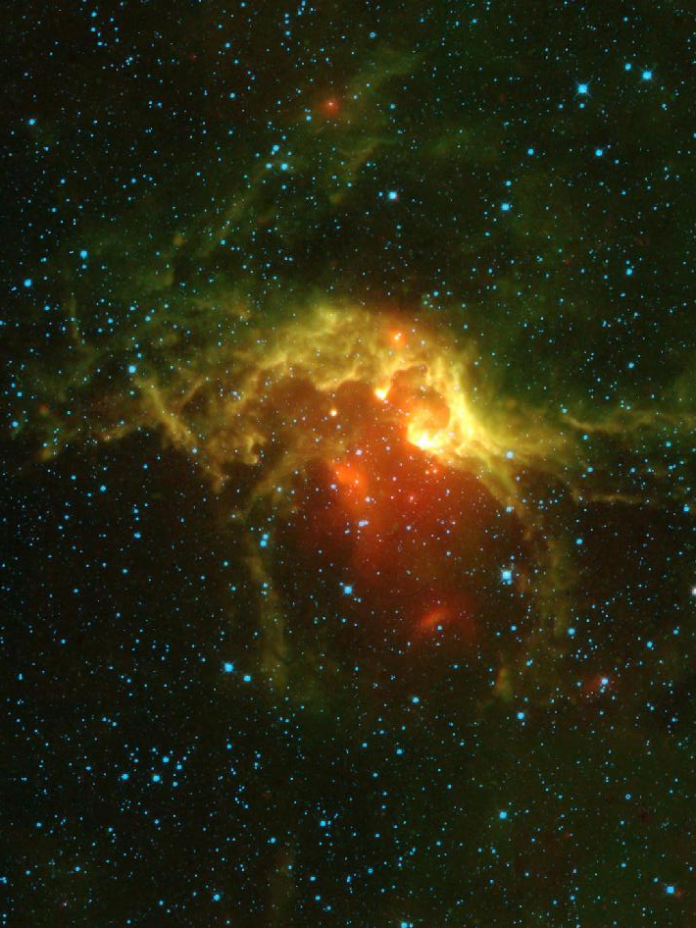
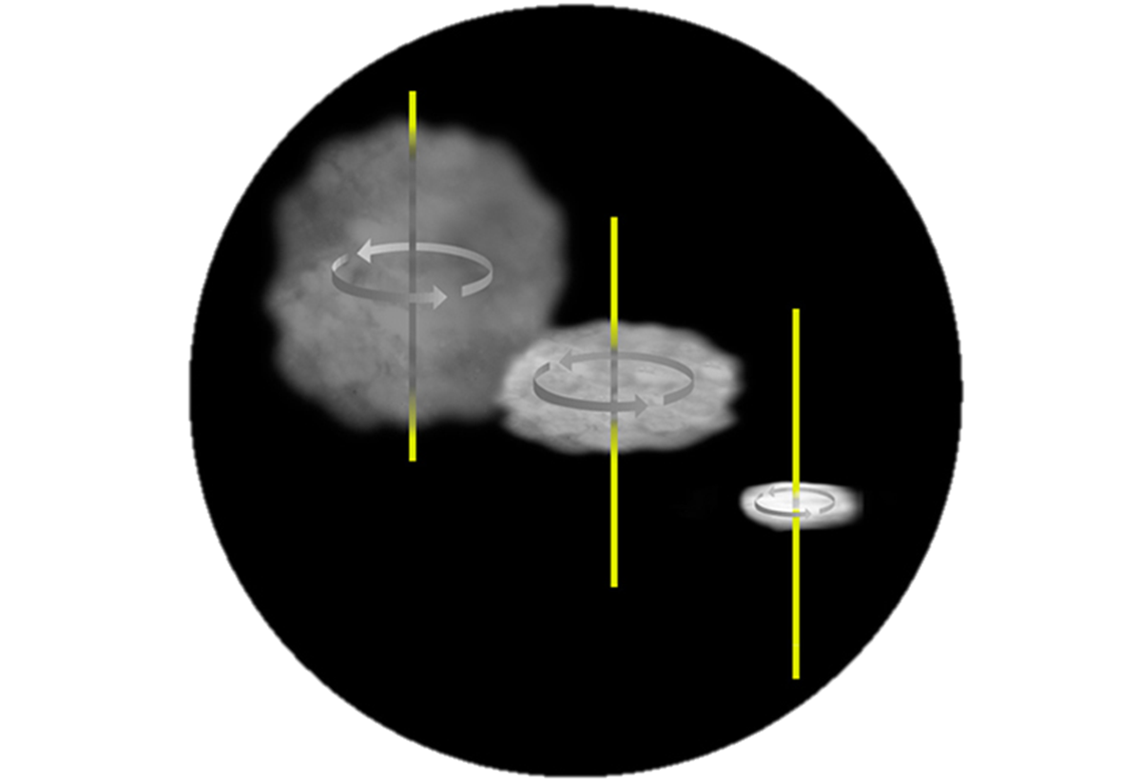
The Nebular Hypothesis Theory
A solar system includes at least one central star, various numbers of planets and their moons, and a variety of other objects (asteroids, meteoroids, comets).
The question we’re answering today is: How are solar systems formed under the Big Bang Theory?
The answer to this is (generally speaking) the Nebular Hypothesis Theory.
The Nebular Hypothesis Theory states: solar systems are formed out of a rotating cloud of dust and gas.
Khan academy

Slide 3
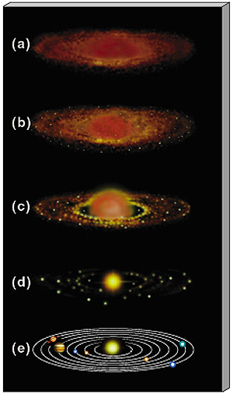
The Steps to Forming a Solar System
Occurring over the course of millions or billions of years, the formation of a solar system progresses through these stages:
Solar Nebula
Formation of the Protoplanetary Disk
Formation of Planetesimals
Formation of Protoplanets
Cooling into stability

Slide 4
Step 1: Formation of Solar Nebulae
Several thousand to millions of years after the Big Bang, matter was not distributed equally throughout the young universe.
During what is known as the Recombination Era, “universe had cooled to a temperature of about 5,000 degrees Fahrenheit (2,700 degrees Celsius), cool enough for electrons and protons to “recombine” into hydrogen atoms”. (space.com)
There were regions in space where matter collected, forming denser areas of basic elemental gases, made primarily out of hydrogen & maybe helium.
These clouds are called nebula (plural, nebulae).

Slide 5
Penzias and Wilson: Discovered Cosmic background radiation, pictured below, illustrating the distribution of energy & Matter in the early universe.
Cosmic background radiation (CMB): This is microwave radiation, the byproduct of the formation of matter created after the Big Bang.

Slide 6
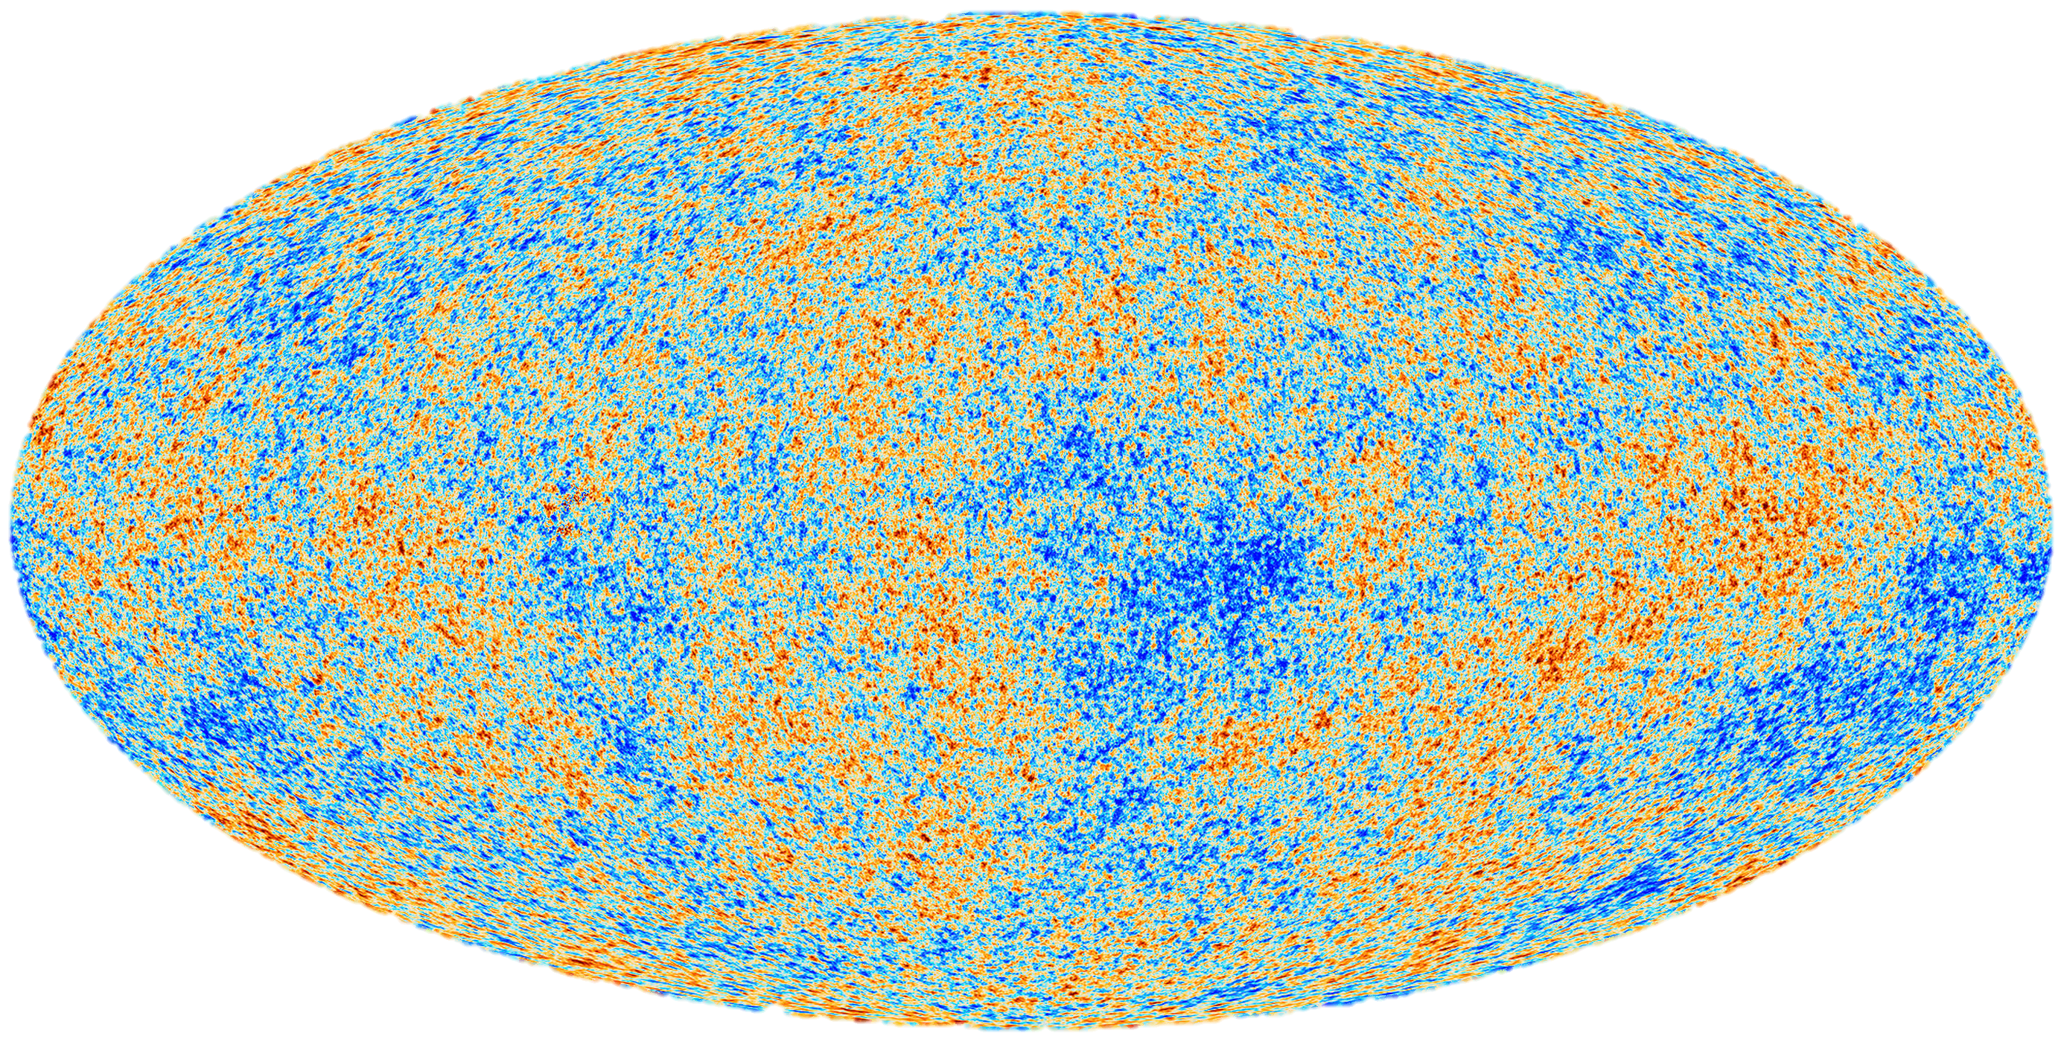
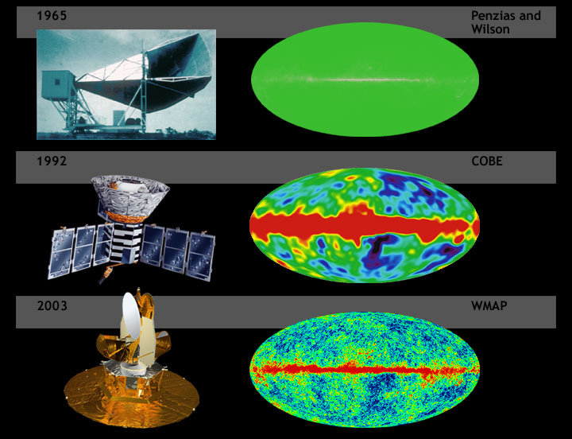
Progression of the CMB images through the course of the last 50 years.
Image produced by Europe’s Plank mission (2013)

Slide 7
Step 1 (continued)
After matter cooled and the first elements were created, the gravitational pull of the individual atoms started drawing closer to other atoms, forming groups, eventually forming clouds of hydrogen, deuterium, and helium.
Given millions (maybe close to 500 million) of years, these coalesced into nebulae.
A nebula is a large cloud of gas and dust, spread over very large areas of space.
Nebula can reach 100 light years in diameter!
It is largely confirmed that nebula create stars.

Slide 8
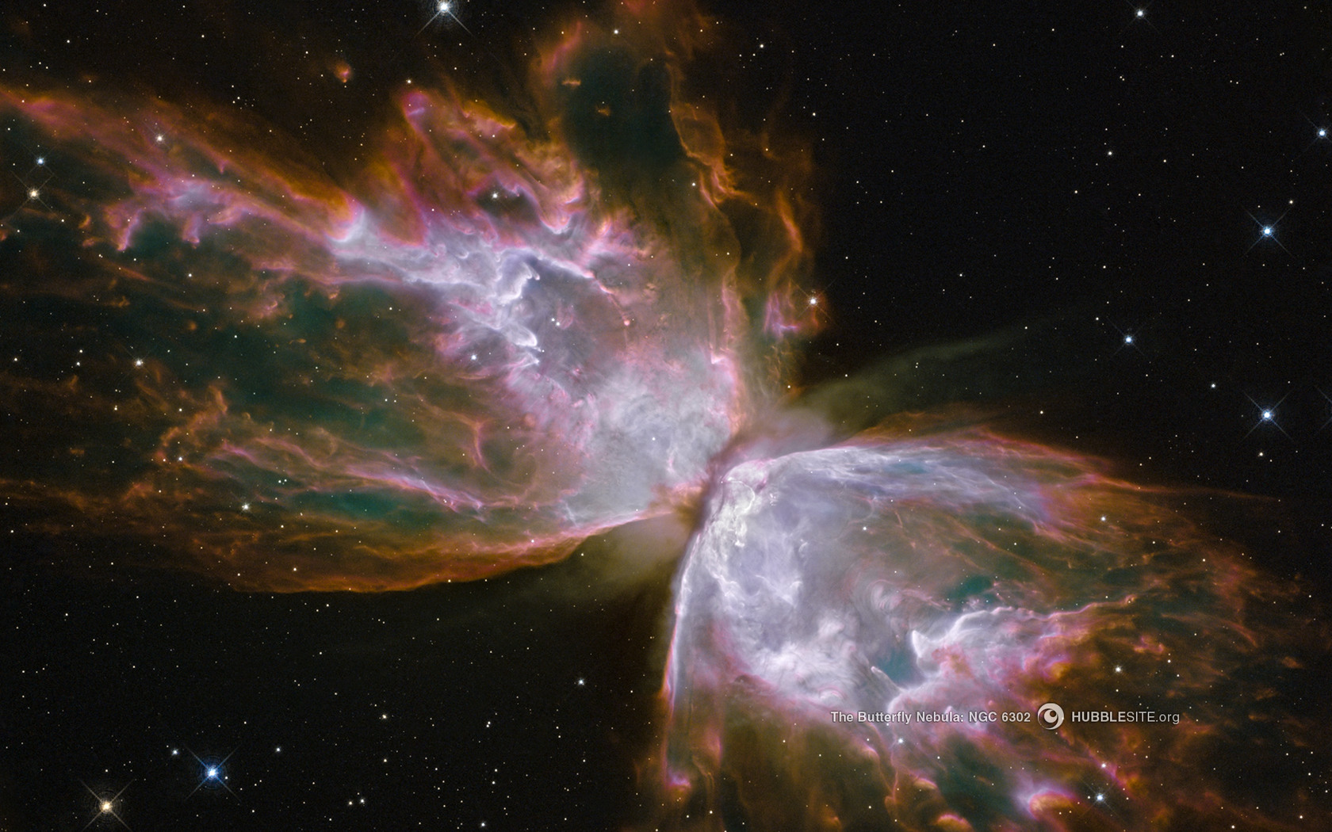
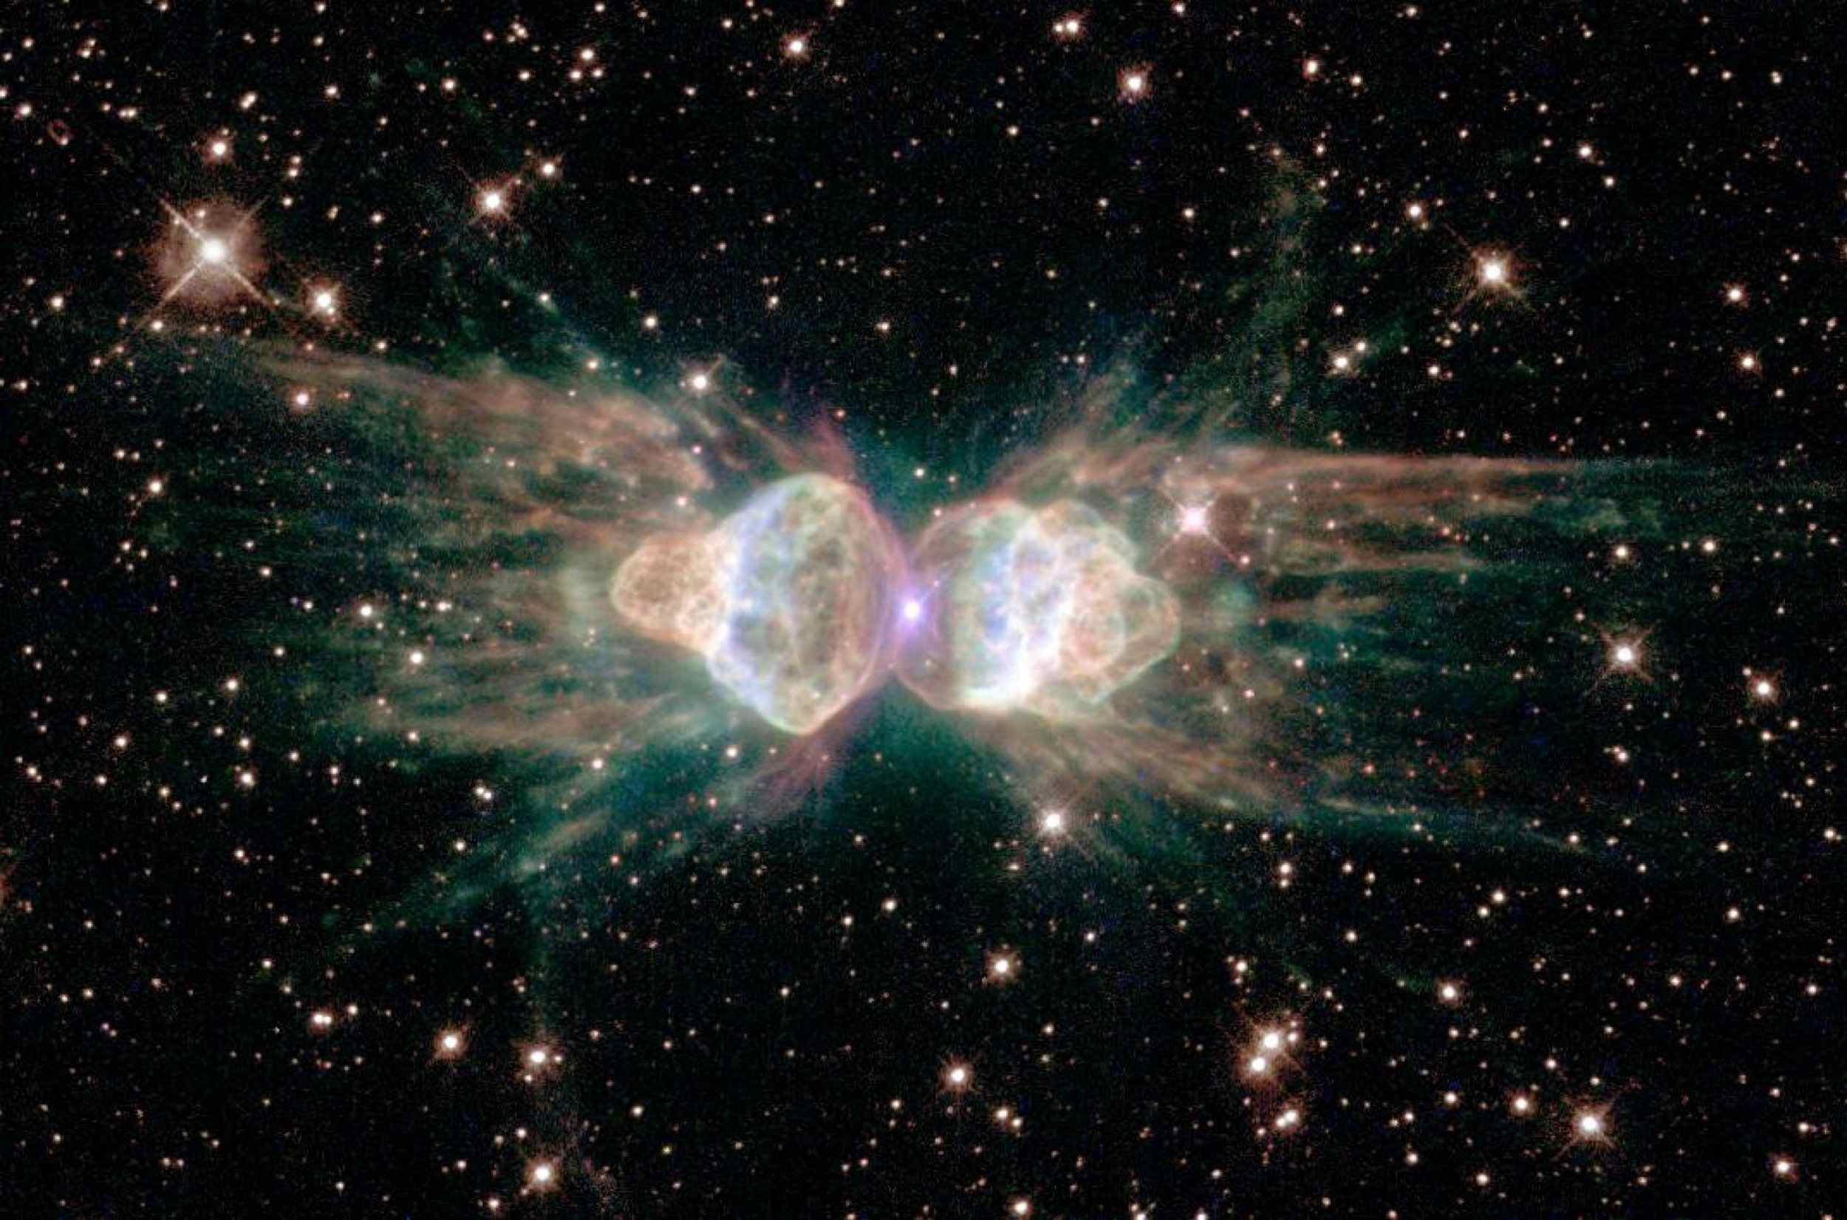
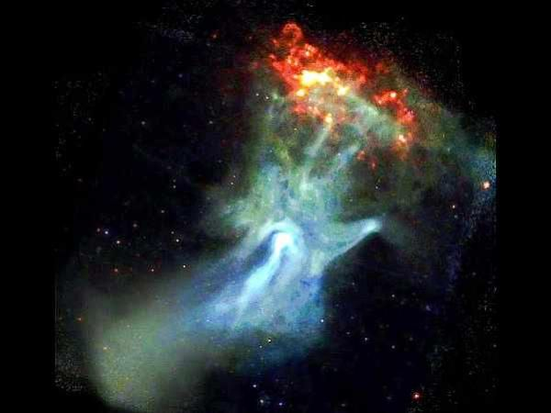
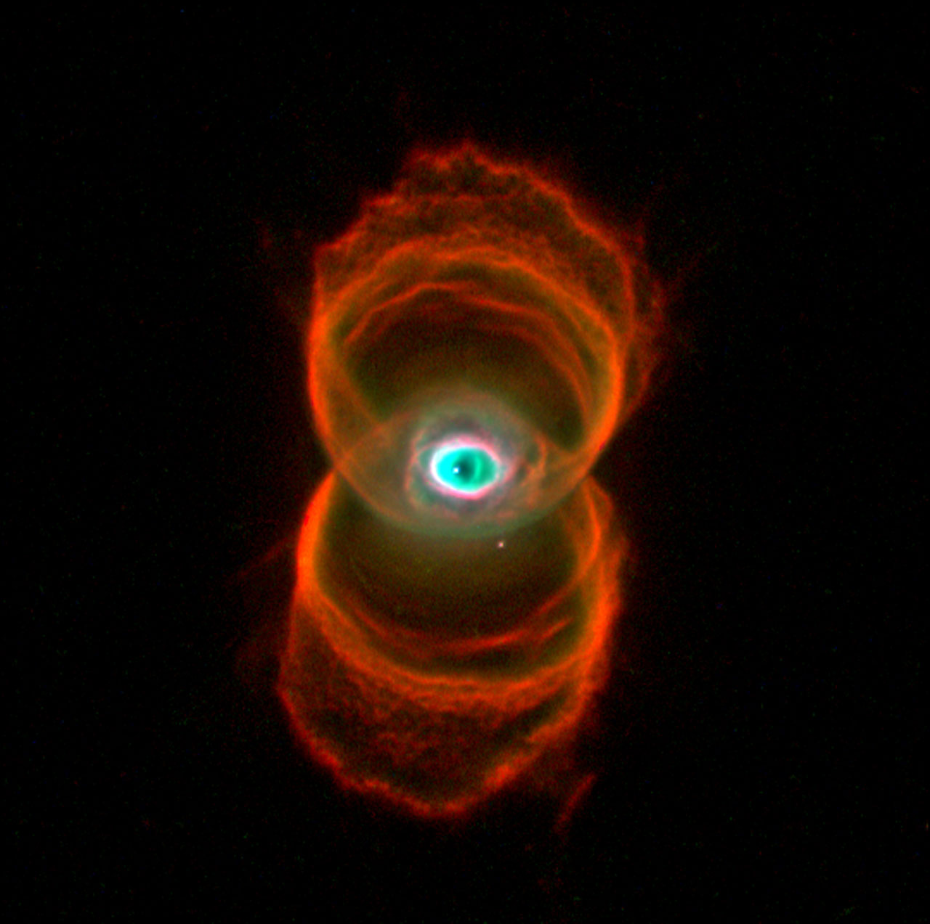
Solar NebulaE
Butterfly Nebula
Ant Nebula
Hand of God Nebula
Hourglass Nebula

Slide 9
Step 2: Formation of a Protoplanetary Disk
The gas molecules within the nebula have gravity that condense into smaller regions with increasing gravity.
The gas, made up of primarily hydrogen and helium, eventually condenses into stars.
These stars have a life cycle, that ends with either supernovas or black holes. (discussed later)
Supernovas are exploding stars that sendoff shockwaves that affect nearby regions within nebulae, causing parts to rotate and their gases to condense into their own stars.
When this happens, nebula clouds are squeezed forming protoplanetary disks.
A protoplanetary disk is a large, rotating, disk-shaped cloud of dust and gas.

Slide 10
Protoplanetary Disk

Slide 11
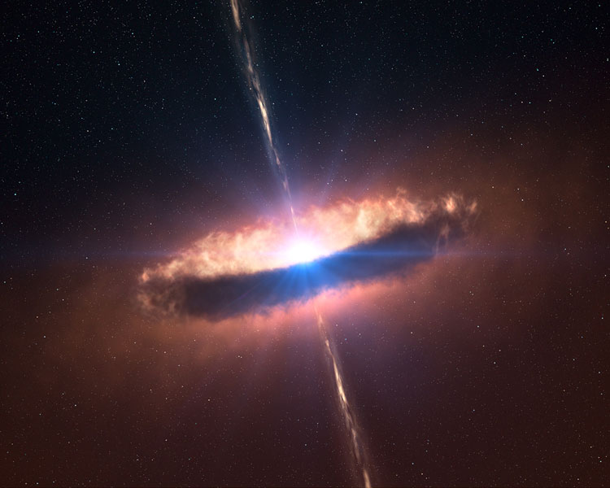
Protoplanetary Disk
Side (ish) view)
Top View

Slide 12
Step 3: Formation of Planetesimals
Protoplanetary disks rotate and when they do they give atoms energy.
These atoms affect one another, collecting into larger and more dense clouds because each have their own gravity.
The atoms in the center of the protoplanetary disk eventually collapse to form the system’s central star, called a protosun.
The atoms in the cloud-disk orbiting the center eventually form planetesimals through the process of accretion.
Accretion is the process of mass gathering more mass through gravitational pull.
There is believed to have been over a billion planetesimals when our solar system was created.

Slide 13
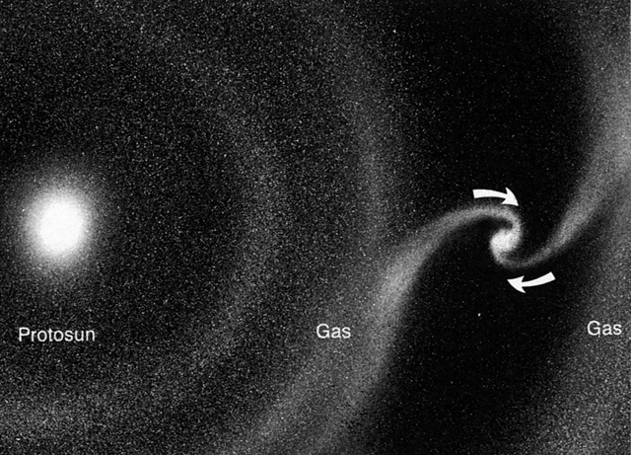
Accretion forming a planetesimal

Slide 14
Step 4: Formation of Protoplanets
Given enough time and collisions, planetesimals combine into fewer and larger protoplanets.
A protoplanet is a large planetary embryo (baby planet) that originated within a protoplanetary disc and has undergone internal melting to produce a differentiated interior.
Protoplanets have various diameters, masses, densities, and compositions based upon where they form.
While the solar system is forming, protoplanets collide with others, forming larger and larger planets.

Slide 15
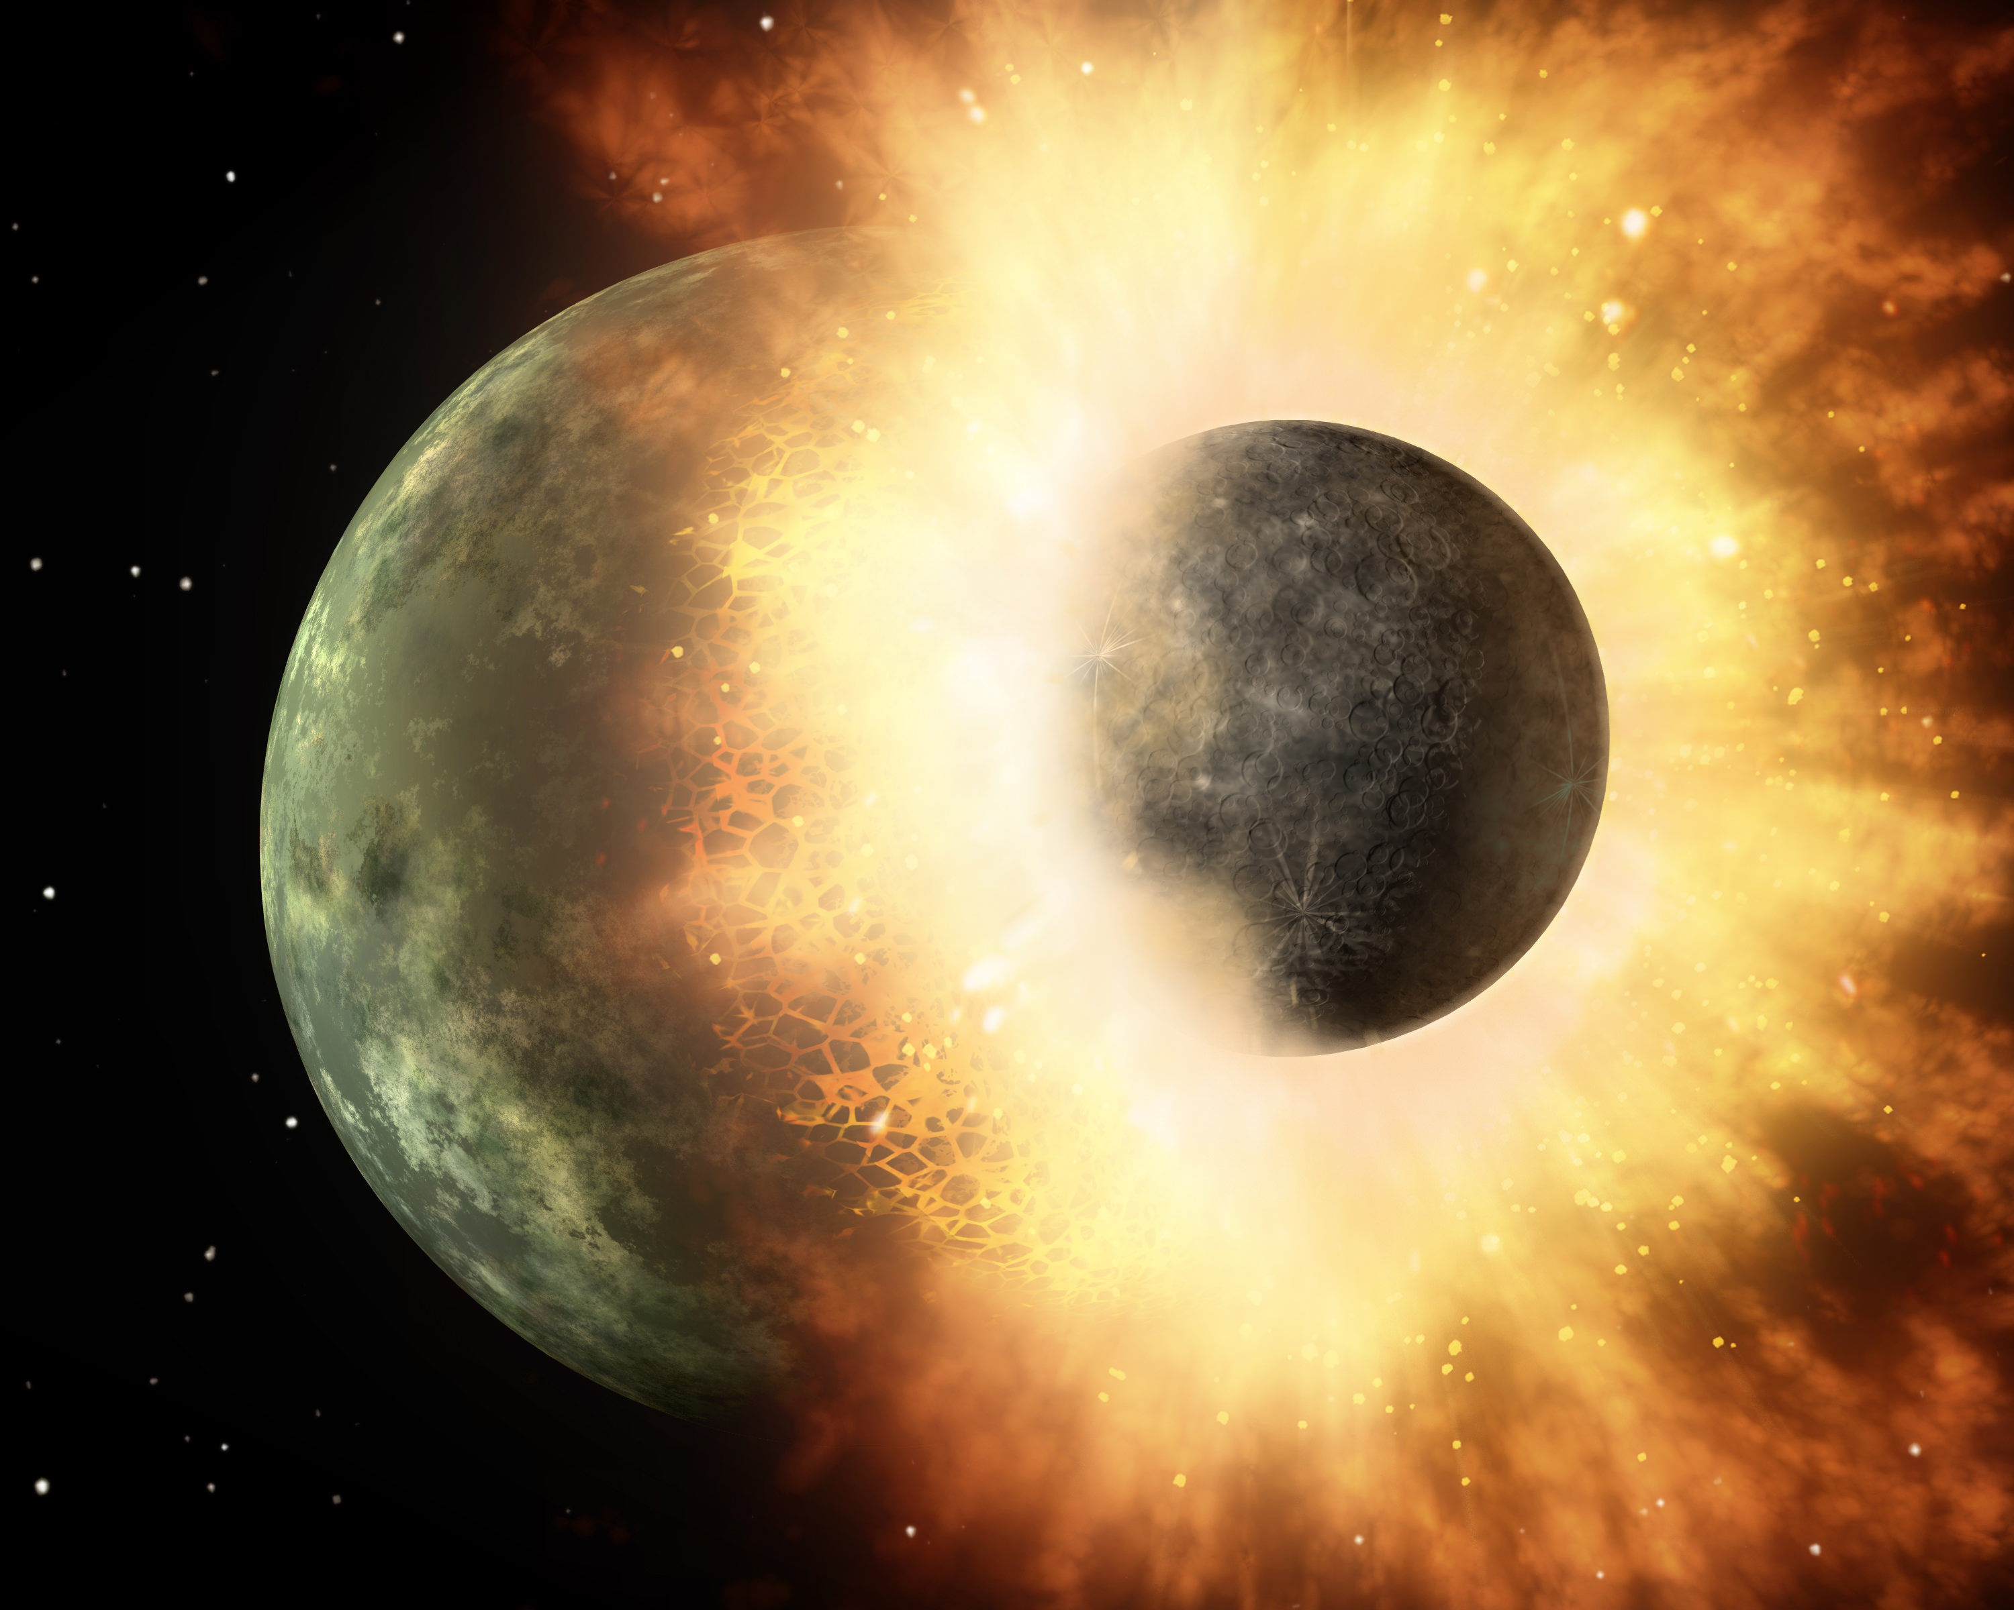
Planets colliding
https://i.giphy.com/media/Kd3VTC2F2bISk/giphy.mp4

Slide 16
The Accretion of Earth
The Earth formed through accretion, absorbing planetisimals (lumps of rock and ice) through collisions. Did the Earth accrete undifferentiated material that then separated into shell and core – in which case, did the planet reach its present mass before differentiating, or was it a more gradual process? Alternatively, core formation might have happened rapidly inside growing planetisimals, so the Earth’s core is combination of these previously formed cores (photo and text credit: Bill Minarik 2003 Nature News and Views Nature 422 126)

Slide 17
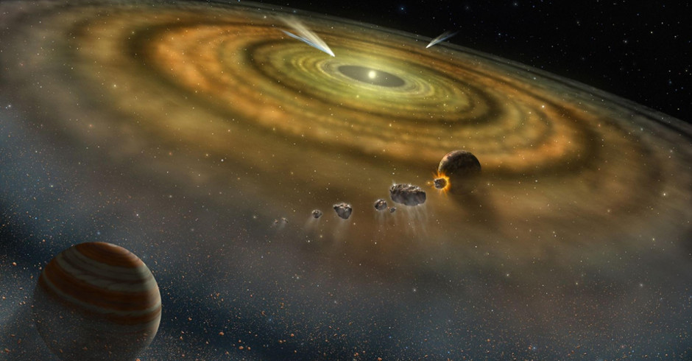
Collisions of protoplanets moving towards stability

Slide 18
Step 5: Cooling into a stable Solar system
After millions of years of collisions, the matter in the solar system has started to aggregate into fewer and fewer protoplantets.
The infant planets settle into orbits around the sun and start to cool.
More transformation happen to the planet depending on what it has been constructed out of, how large the planet has gotten, and most importantly, how close to the sun it is.
Planets closer to the sun (like us) received a lot more heat and that helps them form into denser, terrestrial planets.
Planets farther from the sun are cooler and usually less dense, which form gas giant planets.

Slide 19
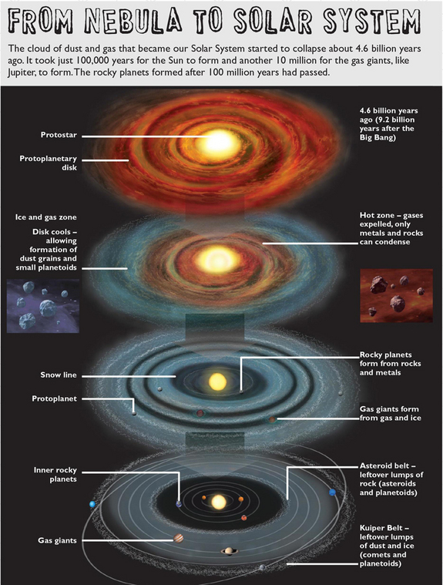
Overview of the formation of our solar system
Starting nearly 9 billion years after the birth of our universe, our solar system started forming over 4 billion years ago.

Slide 20
The finished Product: Our solar system
Terrestrial Planets
Gas Giants
Label the diagram in your notes.

Slide 21
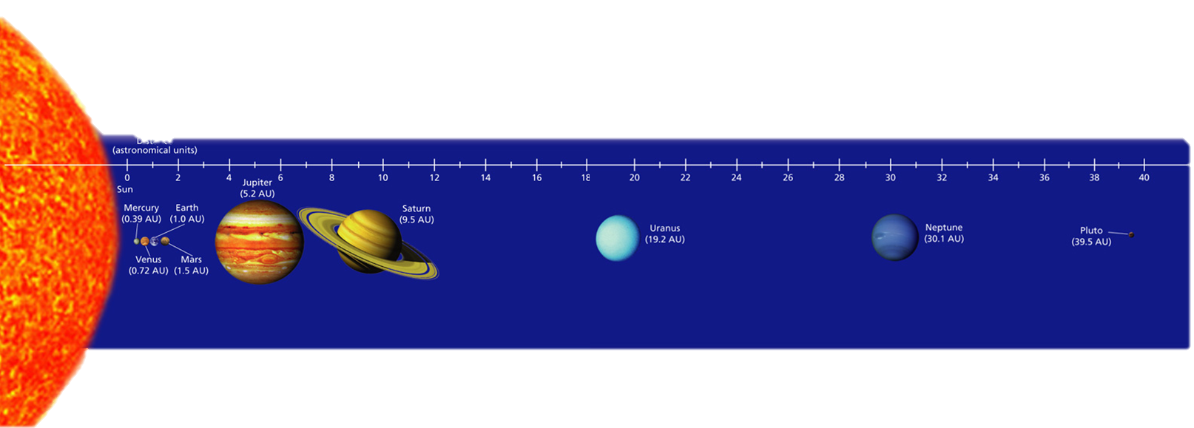
The Current Construction of our Solar System

Slide 22
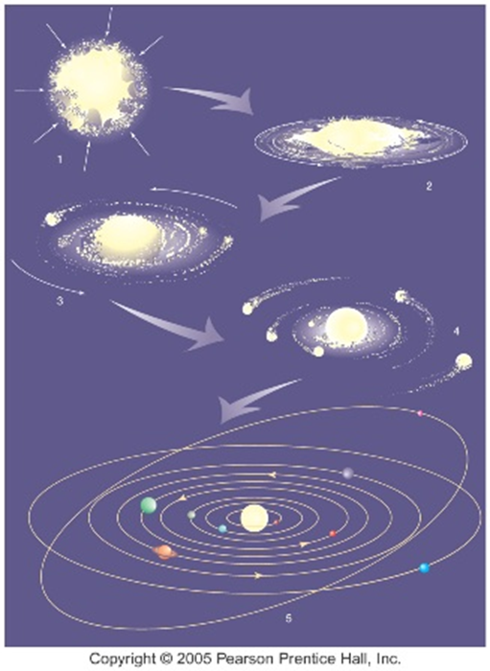
Summarize the Steps
1
2
Review your notes and Summarize the steps of the formation of the solar system.
3
4
5

